Slide 1

Gravitational Wave
Tong Wang

Slide 2
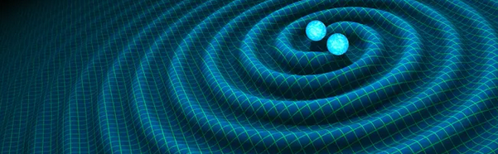
Motivation
In Newton’s view
Space is static and flat
In Einstein’s view
Space is curved and dynamic
Gravitational Waves are “ripples” in the space-time caused by massive objects with extreme accelerations
If we could detect Gravitational Waves, Einstein is right

Slide 3
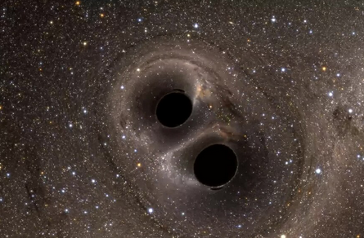
Motivation
Unlike EM radiation, Gravitational Wave have weak interaction with matter and brings original information
Two black holes orbit around each other and merge
Supermassive objects with extreme acceleration
Perfect example that cause gravitational waves
Detect gravitational waves require highly sensitive equipment – LIGO
Using GW200129_065458 as example
Two black holes merge
High signal to noise ratio

Slide 4
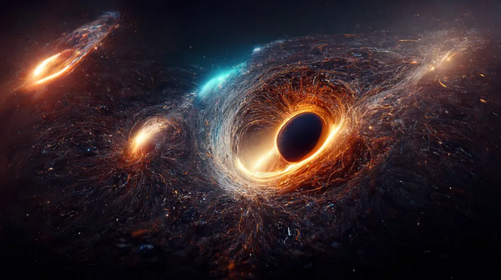
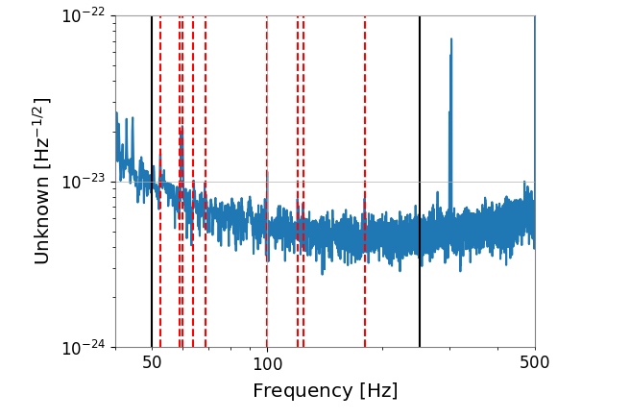
Method
Retrieve Data from LIGO Livingston and LIGO Hanford
LIGO is highly sensitive
Exclude the noise frequency
Black Lines: boundary of window where we will find gravitational waves
Red Dashed Lines are noise frequencies that will be excluded

Slide 5
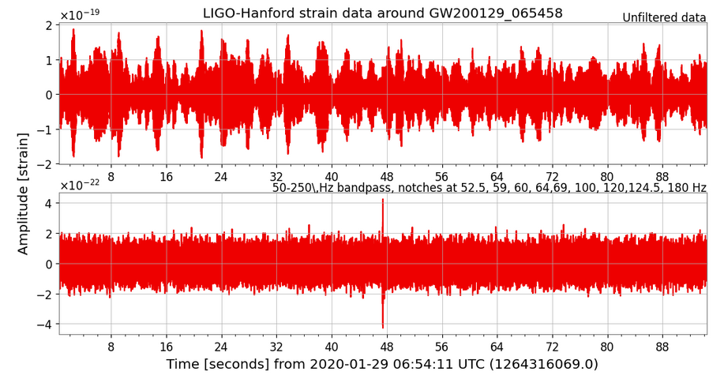
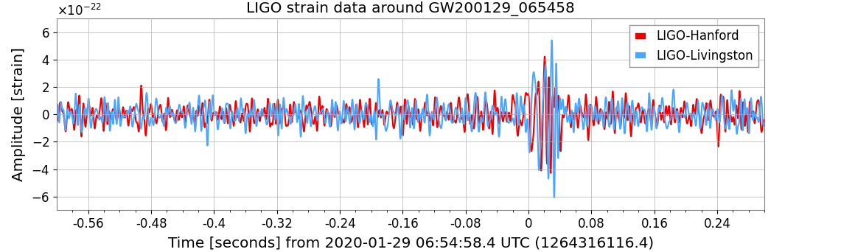
Visualization of Data after filter
Upper figure: Comparison before and after filter
Multiple spikes before filter noise
Only one spike that represent gravitational wave shown in the picture
Lower figure: Date from two LIGO after filter
The data from two LIGO agree with each other
Both have spike at around 0.04 seconds
Gravitational Waves exist and can be
detected by LIGO

Slide 6

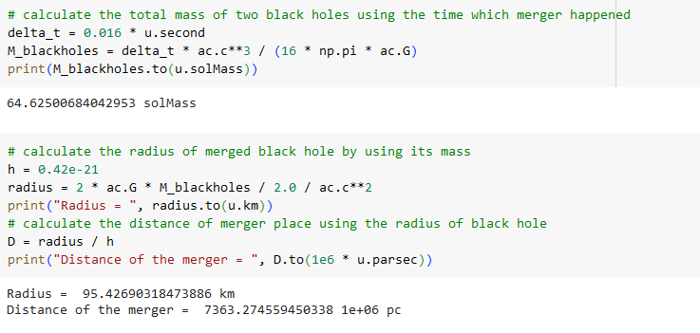
Mass and Radius

Slide 7
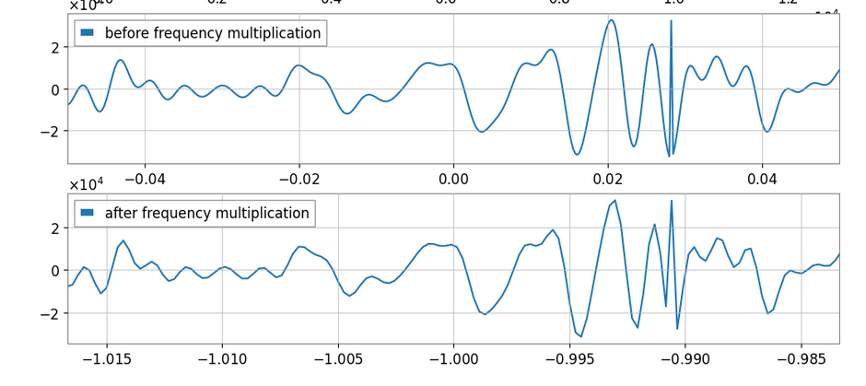

Fourier transform and Sound
First graph is the original frequency
Performing a Fourier Transformation
Reducing the space between waves by a factor 3, which increase the frequency by 3
Result in a more audible sound of gravitational wave with 3 times higher frequency

Slide 8
Conclusion
Einstein’s theory of General Relativity is right
Space is Curved and Dynamic
Gravitational Waves existed and are “ripples” in the space
We can hear the Gravitational Waves by using the data recorded by LIGO
Through capturing the Gravitational Waves, we could get
Mass and radius of merged black holes
The distance of where the event that cause the gravitational wave

